Slide 1
IPFS Based File Storage Access Control and Authentication Model for Secure Data Transfer using Blockchain Technique

Slide 2
INDEX
Abstract
Objective of project
Problem Statement
Scope & Motivation
Introduction
Literature survey
Existing Method
Disadvantages
Proposed method
Advantages
Project Flow
Hardware and Software Requirements
Architecture
Modules
UML’s
References

Slide 3
ABSTRACT
Large files cannot be efficiently stored on blockchains. On one hand side, the blockchain becomes bloated with data that has to be propagated within the blockchain network. On the other hand, since the blockchain is replicated on many nodes, a lot of storage space is required without serving an immediate purpose, especially if the node operator does not need to view every file that is stored on the blockchain. It furthermore leads to an increase in the price of operating blockchain nodes because more data needs to be processed, transferred and stored. IPFS is a file sharing system that can be leveraged to more efficiently store and share large files. It relies on cryptographic hashes that can easily be stored on a blockchain. Nonetheless, IPFS does not permit users to share files with selected parties. This is necessary, if sensitive or personal data needs to be shared. Therefore, this paper presents a modified version of the Interplanetary Filesystem (IPFS) that leverages Ethereum smart contracts to provide access-controlled file sharing. The smart contract is used to maintain the access control list, while the modified IPFS software enforces it. For this, it interacts with the smart contract whenever a file is uploaded, downloaded or transferred. Using an experimental setup, the impact of the access controlled IPFS is analyzed and discussed.
Keywords: 1. Blockchain efficiency,2. IPFS file sharing, 3. Cryptographic hashes,4. Access-controlled sharing, ,6. Data security.

Slide 4
OBJECTIVE OF PROJECT
This project aims to address the inefficiencies and limitations of utilizing blockchain for large file storage by leveraging the Ethereum blockchain to enhance the InterPlanetary File System (IPFS). The objective is to develop and implement an access-controlled IPFS solution, named acl-IPFS, using Ethereum smart contracts. By dynamically managing access control lists on the blockchain, acl-IPFS enables secure and permission-based file sharing. The project seeks to optimize file storage and retrieval, ensuring confidentiality for sensitive data, and establishing a robust linkage between IPFS nodes and Ethereum accounts for permission enforcement.

Slide 5
PROBLEM STATEMENT
The integration of blockchain with file storage, particularly in large files, presents a critical challenge. Storing substantial data on blockchains results in network bloat and increased operational costs for mining nodes. Alternatively, using smart contracts for file storage incurs high transaction costs and strains network bandwidth. Additionally, public accessibility to files on platforms like IPFS poses privacy concerns, especially for sensitive data. To address these issues, this paper focuses on developing acl-IPFS, a modified InterPlanetary File System (IPFS) leveraging the Ethereum blockchain. The objective is to establish access control for IPFS files through an Ethereum smart contract, ensuring secure and permission-controlled file sharing.

Slide 6
SCOPE AND MOTIVATION
SCOPE: This project aims to address the inefficiencies and challenges associated with storing large files on traditional blockchains, specifically focusing on the InterPlanetary File System (IPFS). Leveraging the Ethereum blockchain, the project introduces an access-controlled IPFS system (acl-IPFS) through a smart contract. The scope includes the design and implementation of acl-IPFS, enabling users to register, access, and manage large files securely. The system allows dynamic modification of access control lists, granting and revoking permissions via Ethereum transactions. By establishing a secure and permissioned layer over IPFS, the project enhances the viability of blockchain applications dealing with sensitive or personal data in large files.

Slide 7
SCOPE AND MOTIVATION
MOTIVATION: The motivation behind exploring blockchain technology in agriculture product supply chains lies in the need for greater transparency, efficiency, and security within this vital industry. Traditional supply chain processes often involve numerous stakeholders, complex logistics, and potential risks related to food safety and authenticity. Blockchain technology has the potential to revolutionize how agricultural products are tracked, verified, and authenticated throughout their journey from farm to table. By harnessing the decentralized and tamper-resistant nature of blockchain, we can address critical issues and ensure the integrity and safety of agricultural products for both producers and consumers.

Slide 8
INTRODUCTION
Blockchain applications interact either directly with blockchains or with smart contracts in order to achieve consensus on transactions, data or code execution. A network of heterogeneous nodes stores the blockchain, processes transactions and, if necessary, executes smart contracts. This leads to the following issue when working with large data files. Because the files are usually not required for the blockchain nodes to function, the blockchain becomes bloated, resulting in data being replicated on a large amount of nodes. On one hand, storing large files on the blockchain is inefficient. Limitations on the block size require files to be split and reassembled off-blockchain. Additional data relevant to reassembling files would also have to be stored, requiring either even more space or a distinct system that provides the reassembly information. If smart contracts are leveraged to directly store file parts, the data can more easily be accessed and the reassembly information could be stored as well. However, sending and storing large files, even partially, using smart contracts is expensive (for example regarding gas costs) and needs to be executed at every mining or verifying node. On the other hand, operating the mining nodes becomes more expensive. More data needs to be propagated through the network, processed and stored by the node. Mining nodes would thus require connections with higher bandwidths and more storage space to store the blockchain, even partially, thus leading to increased costs. It concludes that blockchains are not the right platform to share and store large files. Fortunately, file sharing platforms can be leveraged to support applications while keeping the blockchain small in size.

Slide 9
INTRODUCTION
Users can efficiently share large files and still benefit from the blockchain. Cryptographic hashes that serve to securely identify a file’s content, can be send to the latter, thus proving that the file was available to someone at a certain time. One particularly interesting file sharing platform for this purpose, combining file sharing and the mentioned hashes, is the InterPlanetary File System (IPFS) [1]. IPFS identifies, verifies and transfers files relying on the cryptographic hashes of their contents.
Similar to public blockchains, files stored on ipfs can be requested and viewed by anyone who can connect to or deploy an ipfs node. This is an issue for blockchain applications working with large files that contain sensitive or personal data. Therefore, this paper leverages the Ethereum blockchain [2] to provide an access controlled IPFS.

Slide 10
INTRODUCTION
An Ethereum smart contract stores and allows dynamic modification of the access control list. The modified IPFS software, hereinafter named acl-IPFS, whose design and implementation is discussed in the following, can then connect to the smart contract and enforce the permissions given by the access control list. AclIPFS allows users to register new files, and grant and revoke permissions by forming and sending transactions to the smart contract. With every request for a file, acl-IPFS nodes provide the public key and sign the message using a linked Ethereum account. This creates a relation between the nodes and the account, thus allowing the nodes to rely on the smart contract to request permissions and enforce them.

Slide 11
LITERATURE SURVEY
S.NO | YEAR | AUTHORS | TITLE | OUT COMES
1 | International journal, 2015 | G. Zyskind, O. Nathan, and A. Pentland | Decentralizing privacy: Using blockchain to protect personal data | The envisioned result is a decentralized privacy framework that empowers individuals, offering heightened control and security over their sensitive information, thereby addressing contemporary privacy challenges.
2 | Confererence 2018 | G. Wood. | A secure, decentralized generalized transaction ledger | Its outcome lies in establishing a trustless and tamper-resistant platform, enabling a myriad of decentralized applications and smart contracts. Ethereum has become a cornerstone in blockchain technology, fostering innovation and redefining the landscape of decentralized finance and beyond

Slide 12
LITERATURE SURVEY
S.NO | YEAR | AUTHORS | TITLE | OUT COMES
3 | Research paper, 2016 | C. K. and T. M. V | Distributed Access Control in Cloud Computing Systems | The outcome includes valuable insights for designing robust distributed access control mechanisms, contributing to enhanced security and efficiency in cloud computing environments.
4 | International Conference 2017 | S. Alansari, F. Paci, and V. Sassone | A distributed access control system for cloud federations | The outcome envisions enhanced security and streamlined access management within federated cloud environments, contributing to the advancement of robust and efficient access control systems for distributed computing infrastructures.

Slide 13
EXISTING METHOD
The existing system involves blockchain applications interacting with smart contracts for achieving consensus on transactions, data, or code execution. However, the system faces challenges when dealing with large data files, as storing them directly on the blockchain leads to inefficiency and bloating. Smart contracts can be used to store file parts, but this incurs high costs in terms of gas expenses and increased operational expenses for mining nodes. To address this, the paper proposes leveraging the InterPlanetary File System (IPFS) for efficient file sharing while keeping the blockchain size manageable. Additionally, the paper introduces acl-IPFS, a modified IPFS software integrated with an Ethereum smart contract for access-controlled IPFS.

Slide 14
DISADVANTAGES
1. Scalability Concerns:
As the number of files and users increases, the scalability of the IPFS network may become a challenge. The decentralized nature of IPFS relies on nodes to store and retrieve files, and the system may experience bottlenecks as the demand for storage and access control grows.
2. Dependency on Ethereum Blockchain:
The proposed model relies on the Ethereum blockchain for access control, introducing a dependency on the Ethereum network's performance and scalability. Fluctuations in Ethereum transaction costs and network congestion could impact the efficiency and cost-effectiveness of the file storage and access control system.
3. Latency in File Retrieval:
Access control enforcement through smart contracts on the Ethereum blockchain may introduce latency in retrieving files from IPFS. The need to interact with the blockchain for every access request can result in delays, especially during periods of high network activity or congestion.

Slide 15
PROPOSED METHOD
This research introduces a novel system, acl-IPFS, designed to address the challenges of securely sharing large files on the Interplanetary File System (IPFS) while maintaining access control. Leveraging Ethereum blockchain technology, acl-IPFS employs a smart contract to store and dynamically manage an access control list. Users can register, grant, and revoke permissions for files, ensuring secure and controlled access. Each file request involves the acl-IPFS nodes providing a public key and signing the message with a linked Ethereum account, establishing a robust connection between nodes and the smart contract to enforce permissions. This innovative approach enhances file sharing security on IPFS within a decentralized and permissioned framework.

Slide 16
ADVANTAGES
1. Enhanced Security: The integration of a blockchain-based access control and authentication model adds an extra layer of security to IPFS file storage. Blockchain's inherent tamper-resistant nature and cryptographic principles contribute to robust protection against unauthorized access and data tampering.
2. Decentralization: Leveraging IPFS for file storage, coupled with blockchain technology, ensures a decentralized and distributed network. This mitigates the risk of a single point of failure, enhances reliability, and reduces the susceptibility to cyber attacks.
3. Granular Access Control: The proposed model allows for dynamic modification of access control lists through smart contracts. This granular control empowers users to manage permissions efficiently, granting or revoking access as needed, providing flexibility and adaptability in data sharing scenarios.

Slide 17
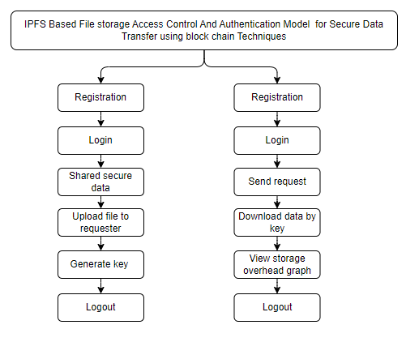
PROJECT FLOW
Figure: work Flow of Proposed system

Slide 18
HARDWARE & SOFTWARE REQUIREMENTS
SOFTWARE REQUIREMENS
Operating System : Windows 7/8/10
Server side Script : HTML, CSS, Bootstrap & JS
Programming Language : Python
Libraries : Flask, Pandas, Mysql.connector, Os, Smtplib, Numpy
IDE/Workbench : PyCharm

Slide 19
HARDWARE & SOFTWARE REQUIREMENTS
SOFTWARE REQUIREMENS
Technology : Python 3.6+
Server Deployment : Xampp Server
Database : MySQL

Slide 20
HARDWARE & SOFTWARE REQUIREMENTS
HARDWARE REQUIREMENTS
Processor - I3/Intel Processor
RAM - 4GB (min)
Hard Disk - 128 GB
Key Board - Standard Windows Keyboard
Mouse - Two or Three Button Mouse
Monitor - Any

Slide 21
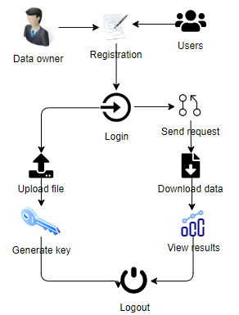
ARCHITECTURE

Slide 22
MODULES
DATA OWNER:
Register: The data owner will register with name, email, password, mobile number, address and profile.
Login: After successful login the data owner can login with valid credentials, like email and password.
Upload file: The data owner can share file to particular file requested user.
Generate key: For security purpose the data owner will share key to user.
Logout: Data owner should be logout.

Slide 23
MODULES
USER MODULE:
Register: The data user will register with name, email, password, mobile number, address and profile.
Login: After successful login the data user can login with valid credentials, like email and password.
Send request file: The data user needs to send a request to data owner for data.
Enter key to download: The user needs to enter key sent by data owners to download file.
View storage overhead graph: The data user can view the output by graphical representation.
Logout: Data user should be logout.

Slide 24
UML DIAGRAMS
Use Case Diagram:
A use case diagram in the Unified Modeling Language (UML) is a type of behavioral diagram defined by and created from a Use-case analysis. Its purpose is to present a graphical overview of the functionality provided by a system in terms of actors, their goals (represented as use cases), and any dependencies between those use cases. The main purpose of a use case diagram is to show what system functions are performed for which actor. Roles of the actors in the system can be depicted.

Slide 25
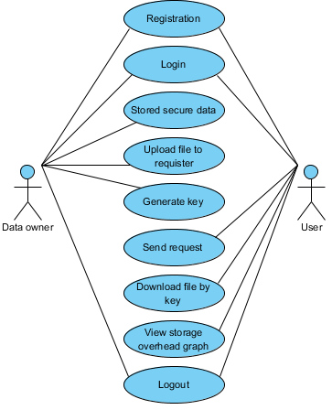
UML DIAGRAMS
Figure: Use Case Diagram

Slide 26
UML DIAGRAMS
Class Diagram:
In software engineering, a class diagram in the Unified Modelling Language (UML) is a type of static structure diagram that describes the structure of a system by showing the system's classes, their attributes, operations (or methods), and the relationships among the classes. It explains which class contains information.

Slide 27
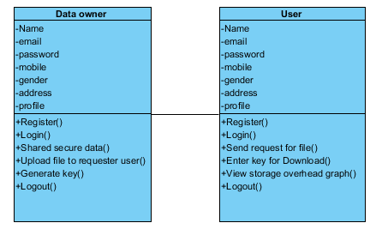
UML DIAGRAMS
Figure: Class diagram

Slide 28
UML DIAGRAMS
Sequence Diagram:
A sequence diagram in Unified Modelling Language (UML) is a kind of interaction diagram that shows how processes operate with one another and in what order. It is a construct of a Message Sequence Chart. Sequence diagrams are sometimes called event diagrams, event scenarios, and timing diagrams.

Slide 29
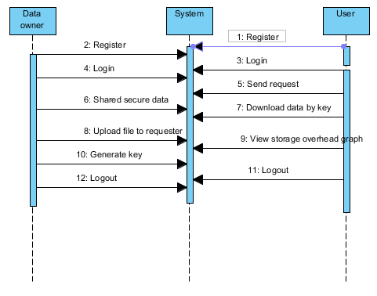
UML DIAGRAMS
Figure: Sequence diagram

Slide 30
UML DIAGRAMS
Collaboration Diagram:
In collaboration diagram the method call sequence is indicated by some numbering technique as shown below. The number indicates how the methods are called one after another. We have taken the same order management system to describe the collaboration diagram. The method calls are similar to that of a sequence diagram. But the difference is that the sequence diagram does not describe the object organization whereas the collaboration diagram shows the object organization.

Slide 31
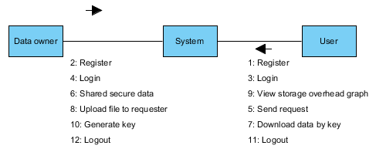
UML DIAGRAMS
Figure: Collaboration diagram

Slide 32
UML DIAGRAMS
Deployment Diagram
Deployment diagram represents the deployment view of a system. It is related to the component diagram. Because the components are deployed using the deployment diagrams. A deployment diagram consists of nodes. Nodes are nothing but physical hardware’s used to deploy the application.

Slide 33
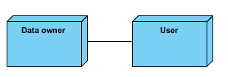
UML DIAGRAMS
Figure: Deployment diagram

Slide 34
UML DIAGRAMS
Activity Diagram:
Activity diagrams are graphical representations of workflows of stepwise activities and actions with support for choice, iteration and concurrency. In the Unified Modelling Language, activity diagrams can be used to describe the business and operational step-by-step workflows of components in a system. An activity diagram shows the overall flow of control.

Slide 35
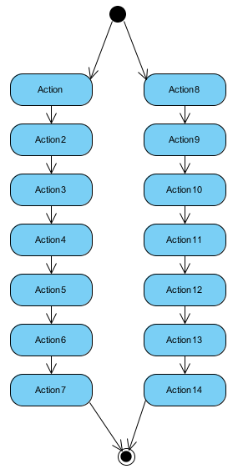
UML DIAGRAMS
Figure: Activity diagram

Slide 36
UML DIAGRAMS
Component Diagram:
A component diagram, also known as a UML component diagram, describes the organization and wiring of the physical components in a system. Component diagrams are often drawn to help model implementation details and double-check that every aspect of the system's required functions is covered by planned development.

Slide 37
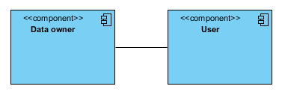
UML DIAGRAMS
Figure: Component diagram

Slide 38
UML DIAGRAMS
ER Diagram:
An Entity–relationship model (ER model) describes the structure of a database with the help of a diagram, which is known as Entity Relationship Diagram (ER Diagram). An ER model is a design or blueprint of a database that can later be implemented as a database. The main components of E-R model are: entity set and relationship set.
An ER diagram shows the relationship among entity sets. An entity set is a group of similar entities and these entities can have attributes. In terms of DBMS, an entity is a table or attribute of a table in database, so by showing relationship among tables and their attributes, ER diagram shows the complete logical structure of a database. Let’s have a look at a simple ER diagram to understand this concept.

Slide 39
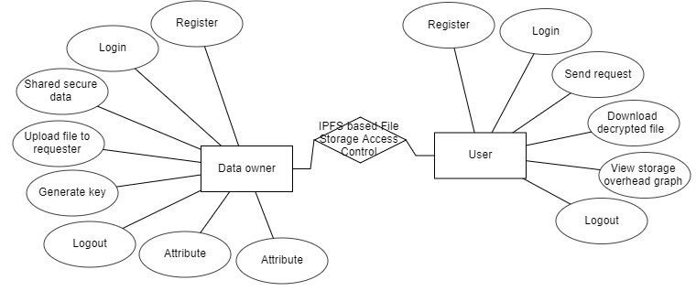
UML DIAGRAMS
Figure: ER diagram

Slide 40
UML DIAGRAMS
DFD Diagram:
A Data Flow Diagram (DFD) is a traditional way to visualize the information flows within a system. A neat and clear DFD can depict a good amount of the system requirements graphically. It can be manual, automated, or a combination of both. It shows how information enters and leaves the system, what changes the information and where information is stored. The purpose of a DFD is to show the scope and boundaries of a system as a whole. It may be used as a communications tool between a systems analyst and any person who plays a part in the system that acts as the starting point for redesigning a system.

Slide 41

UML DIAGRAMS
Figure: Context Level diagram

Slide 42
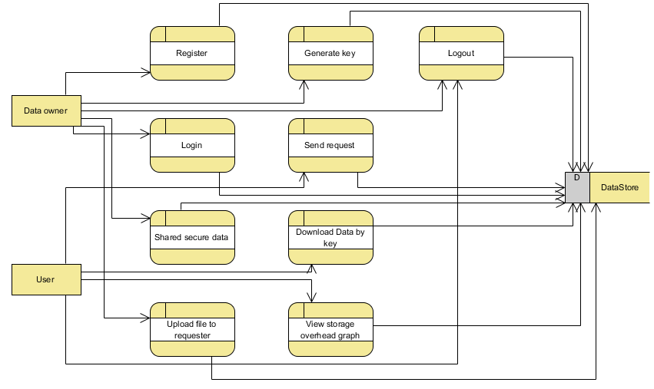
UML DIAGRAMS
FigureLevel-1 diagram

Slide 43
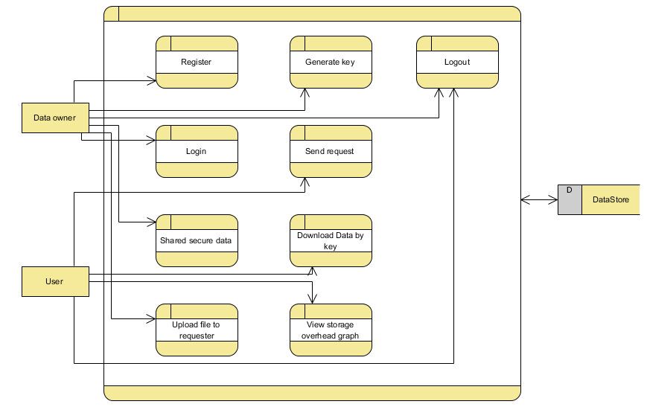
UML DIAGRAMS
Figure:Level-2 diagram

Slide 44
REFERENCES
[1] G. Zyskind, O. Nathan, and A. Pentland, “Decentralizing privacy: Using blockchain to protect personal data,” in 2015 IEEE Security and Privacy Workshops, May 2015, pp. 180–184.
[2] G. Wood. (2018) Ethereum: A secure, decentralized generalized transaction ledger. [Online
[3] S. Nakamoto, “Bitcoin: A peer-to-peer electronic cash system,” 2008.
[4] X. Xu, I. Weber, M. Staples, L. Zhu, J. Bosch, L. Bass, C. Pautasso, and P. Rimba, “A taxonomy of blockchain-based systems for architecture design,” in 2017 IEEE International Conference on Software Architecture (ICSA), April 2017, pp. 243–252.
[5] C. K. and T. M. V., Distributed Access Control in Cloud Computing Systems. Wiley-Blackwell, 2016, ch. 35, pp. 417– 432. [Online].

Slide 45
REFERENCES
[6] S. Alansari, F. Paci, and V. Sassone, “A distributed access control system for cloud federations,” in 2017 IEEE 37th International Conference on Distributed Computing Systems (ICDCS), June 2017, pp. 2131–2136.
[7] Y. Zhang, S. Kasahara, Y. Shen, X. Jiang, and J. Wan, “Smart contract-based access control for the internet of things,” CoRR, vol. abs/1802.04410, 2018. [Online]. Available: http://arxiv.org/abs/1802. 04410.
[8] E. B. Sasson, A. Chiesa, C. Garman, M. Green, I. Miers, E. Tromer, and M. Virza, “Zerocash: Decentralized anonymous payments from bitcoin,” in 20.
[9] I. Baumgart and S. Mies, “S/kademlia: A practicable approach towards secure key-based routing,” in Proceedings of the 13th International Conference on Parallel and Distributed Systems - Volume 02, ser. ICPADS ’07. Washington, DC, USA: IEEE Computer Society, 2007, pp. 1–8. [Online]. Available: http://dx.doi.org/10.1109/ICPADS.2007. 4447808.

